Slide 1
Phase plane analysis
Demo class with pplane8

Slide 2
Phase plane analysis – Purpose
For most systems, quantitative analysis is too complicated
Phase portraits allow us to understand the behavior of the system in a qualitative manner
Changes in the behaviour of the system as the values of the parameters involved are changed can be understood – twisting different knobs
Nullclines help us understand where the flow of the system is purely vertical or horizontal
From nullclines to phase portrait
Effect of different initial conditions of the system can be understood

Slide 3

$\dot{x}=ax$
$\dot{y}=−y$
The equations are uncoupled.
A single fixed point at origin (0,0). But the value of the parameter a, modifies the behavior of the system.

Slide 4
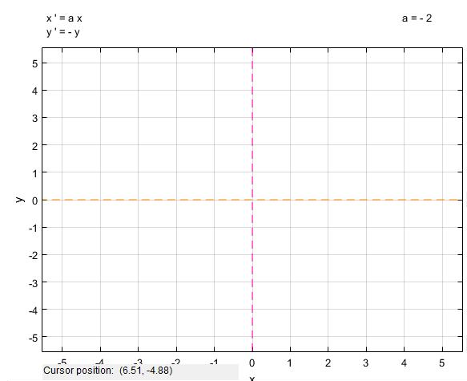
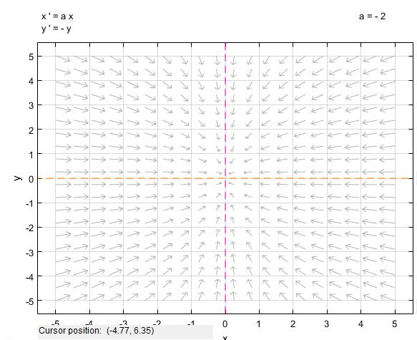
x nullcline
y nullcline
Nullclines
Nullclines with stability
Stable Node

Slide 5
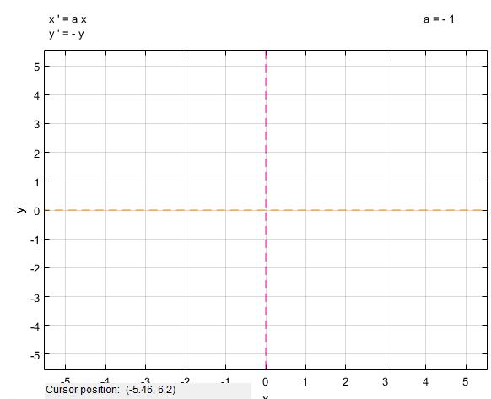
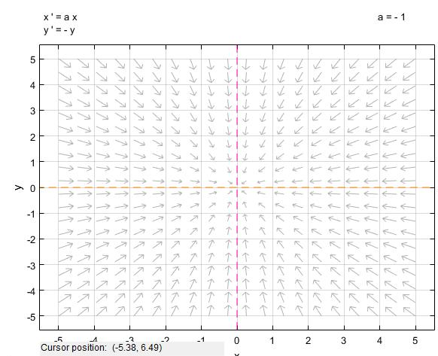
x nullcline
y nullcline
Nullclines
Nullclines with stability
Stable Node

Slide 6

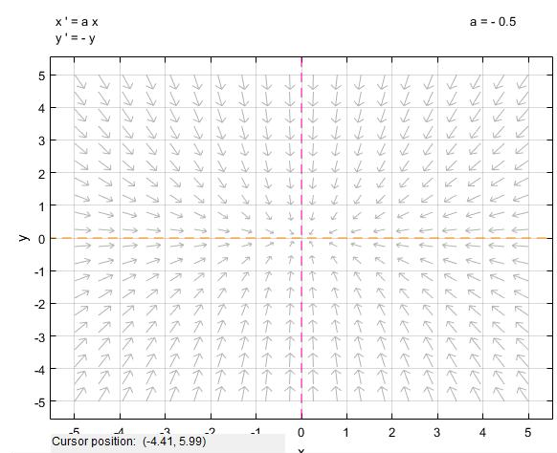
x nullcline
y nullcline
Nullclines
Nullclines with stability
Stable Node

Slide 7
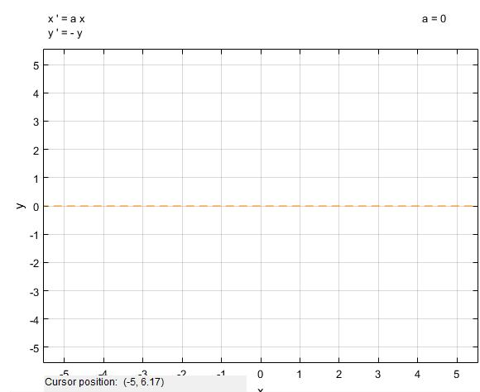
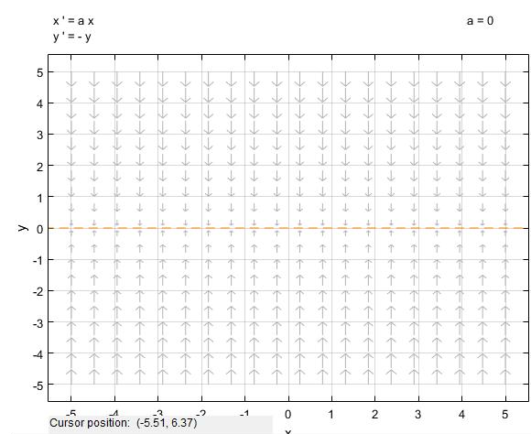
x nullcline
y nullcline
Nullclines
Nullclines with stability
Line of fixed points

Slide 8
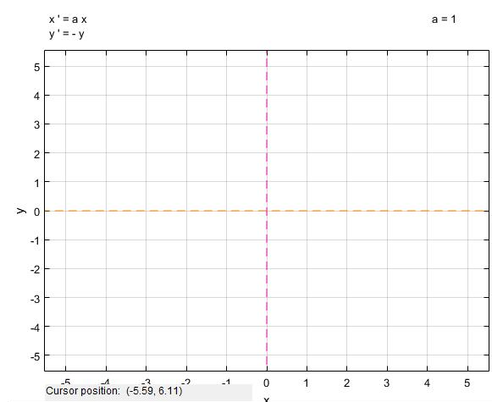
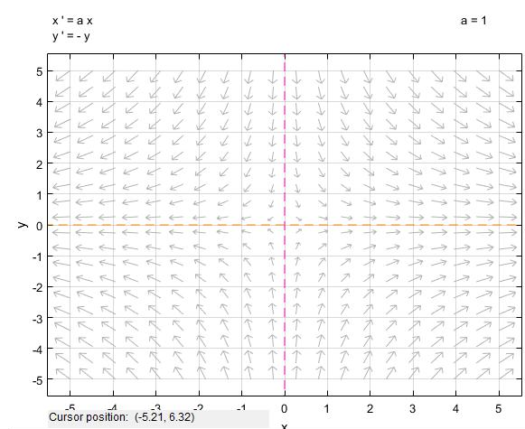
x nullcline
y nullcline
Nullclines
Nullclines with stability
Saddle Node

Slide 9
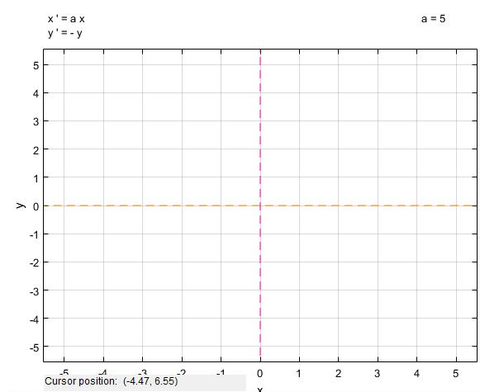
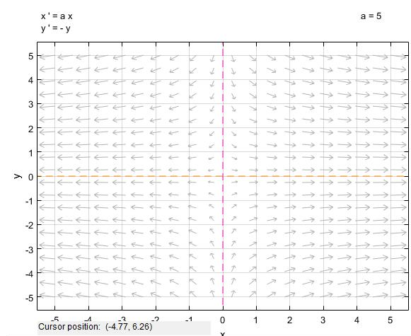

x nullcline
y nullcline
Nullclines
Nullclines with stability
Saddle Node

Slide 10
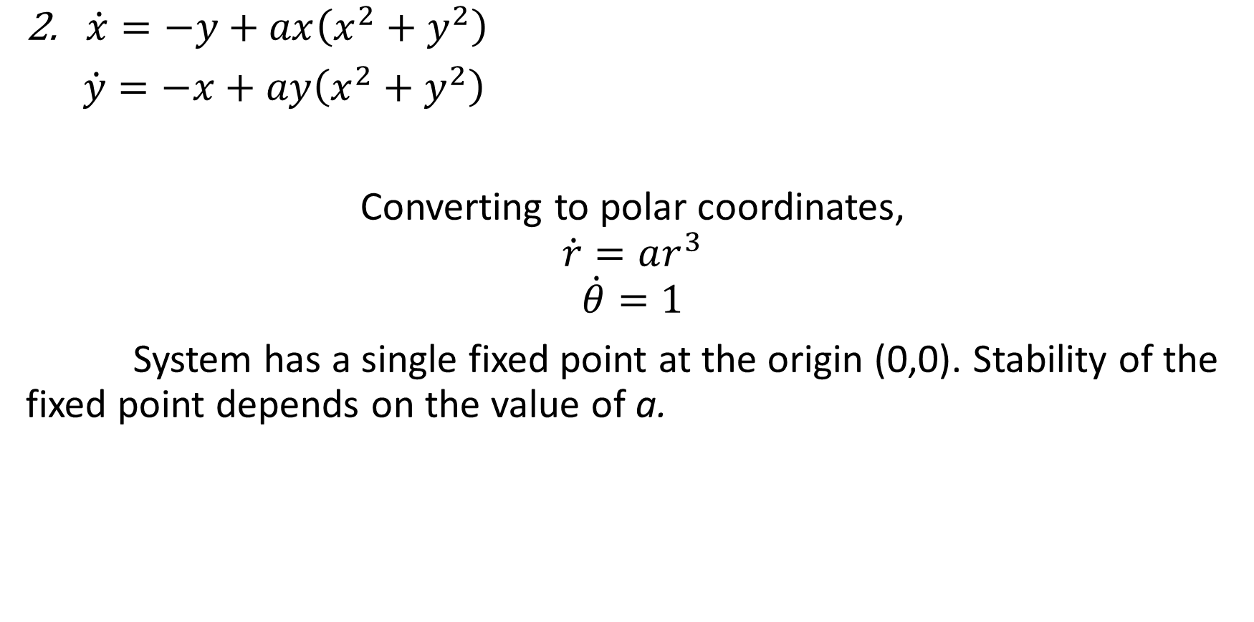
$\dot{x}=−y+ax\left(x^{2}+y^{2}\right)$
$\dot{y}=−x+ay\left(x^{2}+y^{2}\right)$
Converting to polar coordinates,
$$\dot{r}=ar^{3}$$
$$\dot{θ}=1$$
System has a single fixed point at the origin (0,0). Stability of the fixed point depends on the value of a.

Slide 11
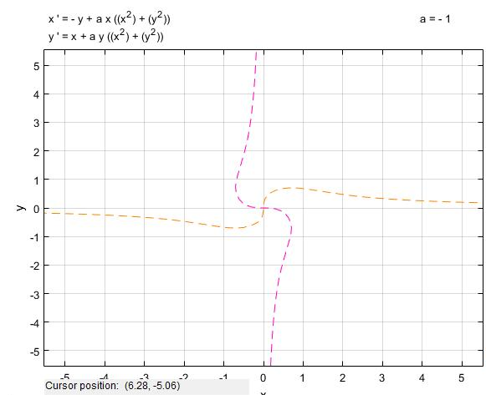
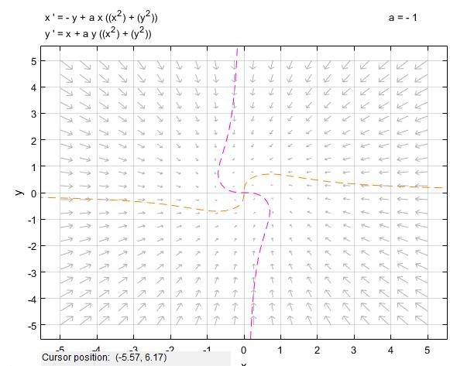
x nullcline
y nullcline
Nullclines
Nullclines with stability
Stable Spiral

Slide 12
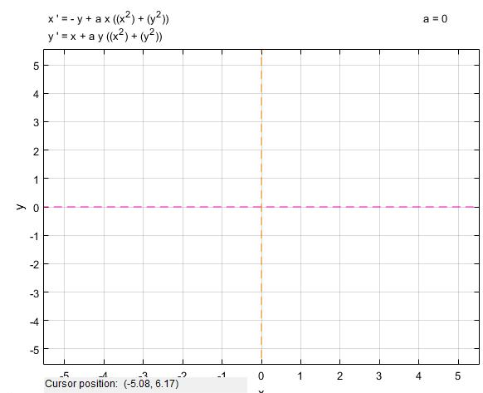
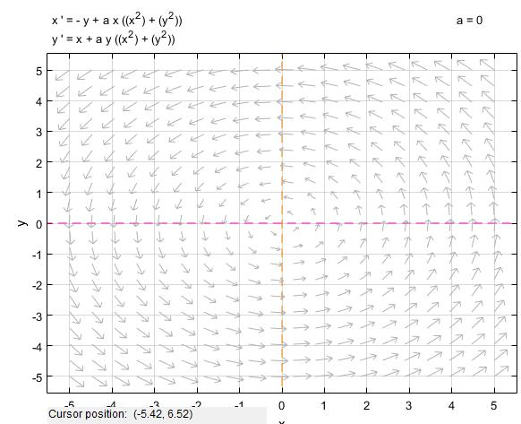
x nullcline
y nullcline
Nullclines
Nullclines with stability
Center

Slide 13
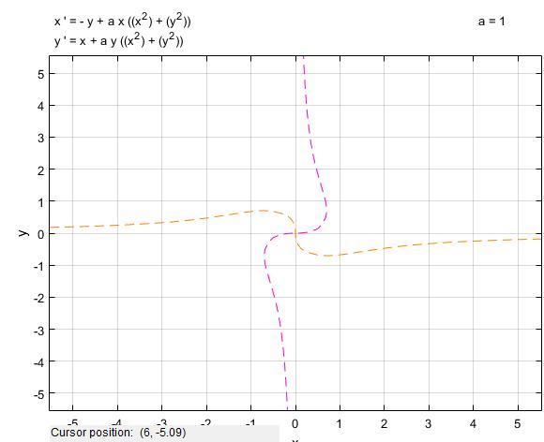
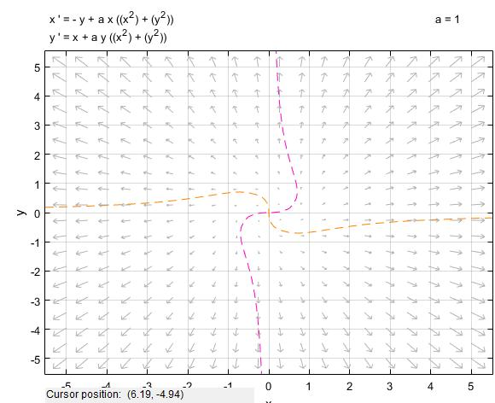
x nullcline
y nullcline
Nullclines
Nullclines with stability
Unstable Spiral

Slide 14

$\dot{x}=5x−x^{2}−xy$
$\dot{y}=−2y+xy$
The x nullclines occur at, x = 0 and x = 5-y
The y nullclines occur at, y = 0 and x = 2
The fixed points are (0,0), (5,0) and (2,3).

Slide 15
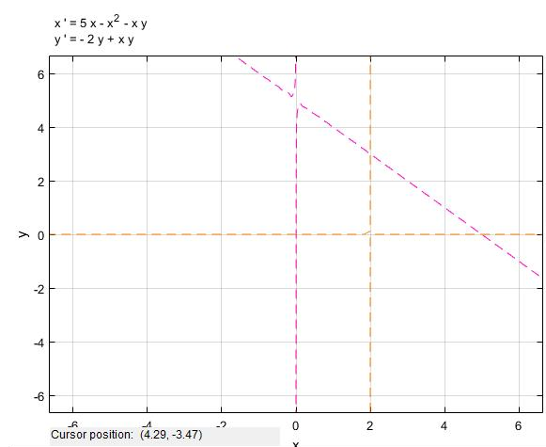
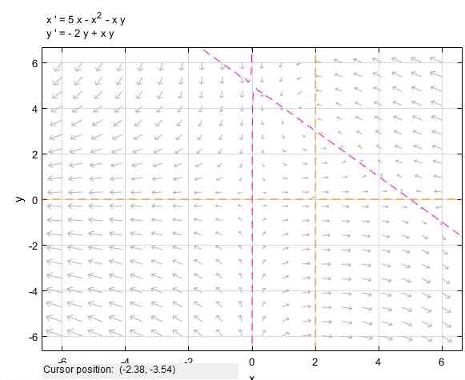
x nullcline
y nullcline
Nullclines
Nullclines with stability
Stable Spiral
Saddle Node

Slide 16

$\dot{x}= y^{2}−x^{2}$
$\dot{y}=x−1$
The x nullclines are y = +x and y nullcline is x = 1
The fixed points occur at (1,1) and (1,-1)

Slide 17
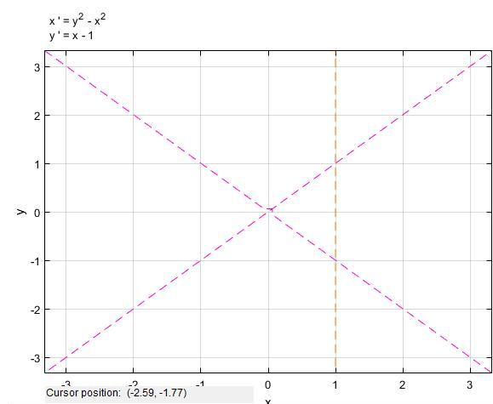
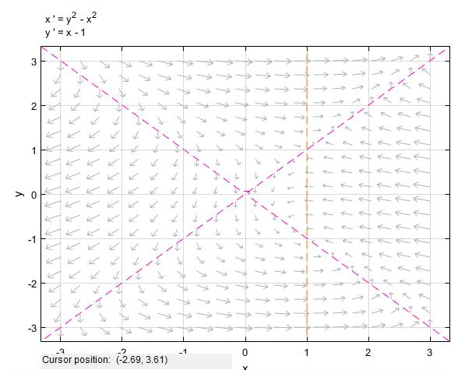
x nullcline
y nullcline
Nullclines
Nullclines with stability
Unstable Node
Stable Focus

Slide 18

$\dot{x}= x^{2}−y$
$\dot{y}=y^{2}−x$
The x nullclines are y = $x^{2}$ and y nullcline is x = $y^{2}$
The fixed points occur at (0,0) and (1,1)

Slide 19
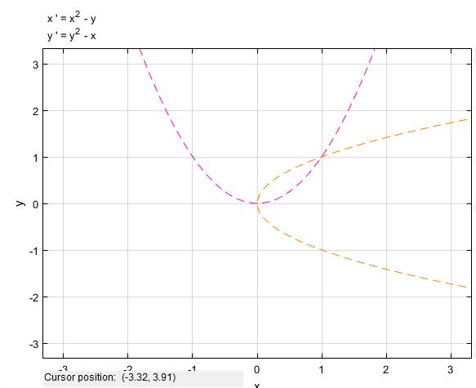
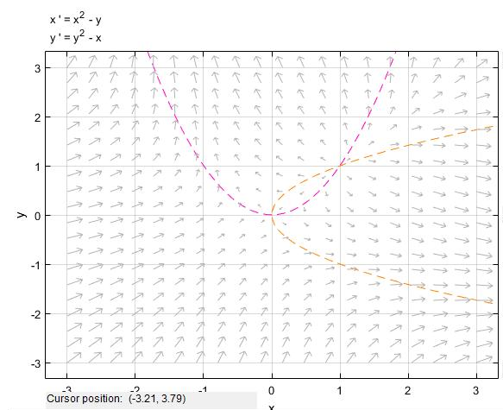
x nullcline
y nullcline
Nullclines
Nullclines with stability
Saddle Node
Unstable Node

Slide 20

$\dot{x}=x(y^{2}−y)$
$\dot{y}=x−y$
The x nullclines are x = 0, y = 0, y = 1 and y nullcline is x = y
The fixed points occur at (0,0) and (1,1)

Slide 21
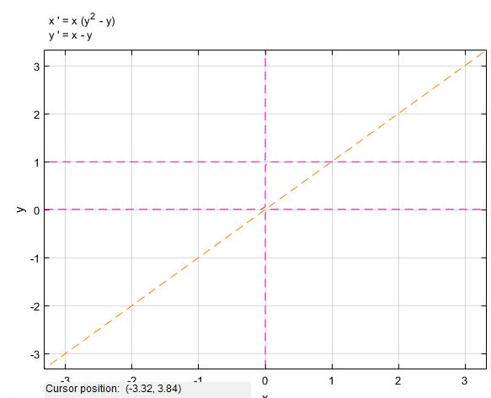
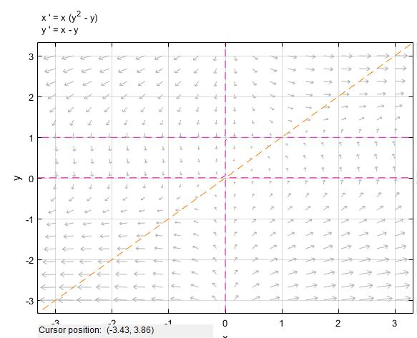
x nullcline
y nullcline
Nullclines
Nullclines with stability
Saddle Node

Slide 22

7. $\dot{x}=2xy$
$\dot{y}=y^{2}−x^{2}$
The x nullclines are x = 0, y = 0 and y nullcline is x = y & x=-y
The fixed points occur at (0,0)

Slide 23
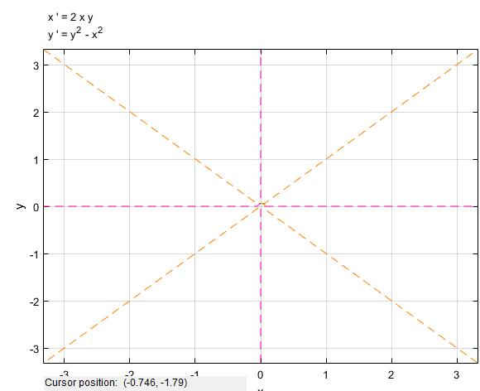
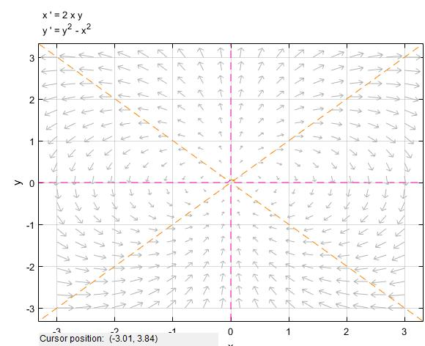
x nullcline
y nullcline
Nullclines
Nullclines with stability
Dipole Fixed point

Slide 24

8. $\dot{x}=y+y^{2}$ $\dot{y}=−x+\frac{1}{5}y−xy+\frac{6}{5}y^{2}$
The x nullclines are y= 0, y = -1, and y nullcline is x= $\frac{\left(y+6y^{2}\right)}{5(1+y)}$
The fixed point occur at (0,0)

Slide 25
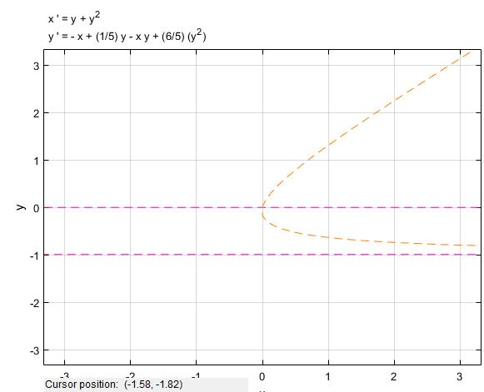
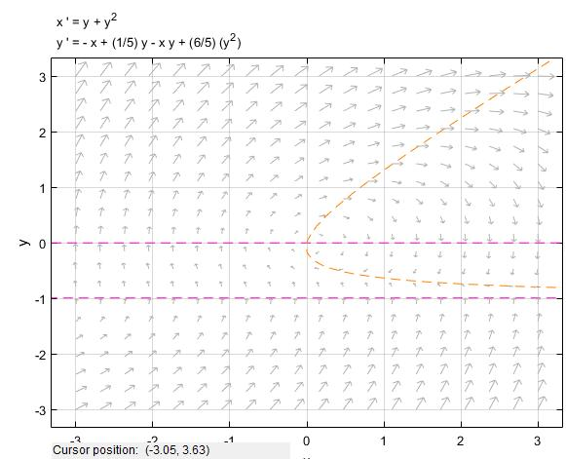
x nullcline
y nullcline
Nullclines
Nullclines with stability
Stable Limit Cycle

Slide 26

9. $\dot{x}=y+y^{2}$ $\dot{y}=−\frac{1}{2}x+\frac{1}{5}y−xy+\frac{6}{5}y^{2}$
The y nullclines are y= 0, y = -1, and x nullcline is x= $\frac{2\left(y+6y^{2}\right)}{5(1+2y)}$
The fixed point occur at (0,0) and (-2,-1)

Slide 27
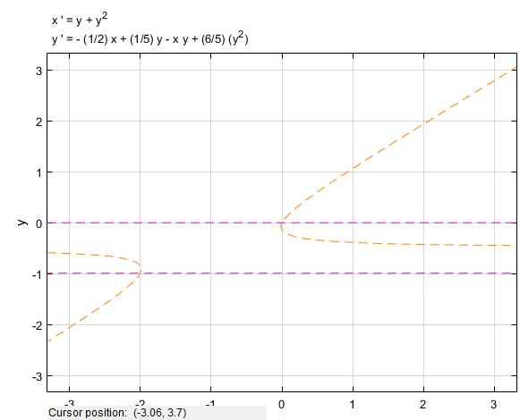
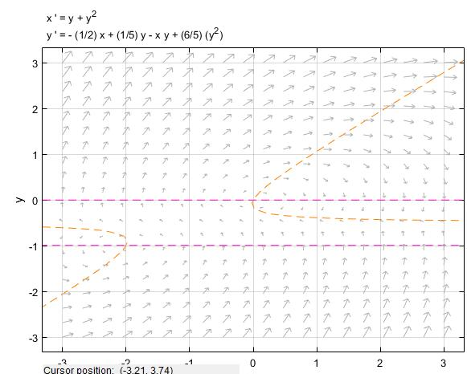
x nullcline
y nullcline
Nullclines
Nullclines with stability
Stable Spiral
Stable Limit Cycle

